Slide 1
Sampling Distribution
for
sample proportion

Slide 2
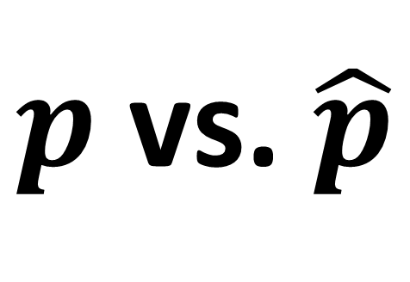
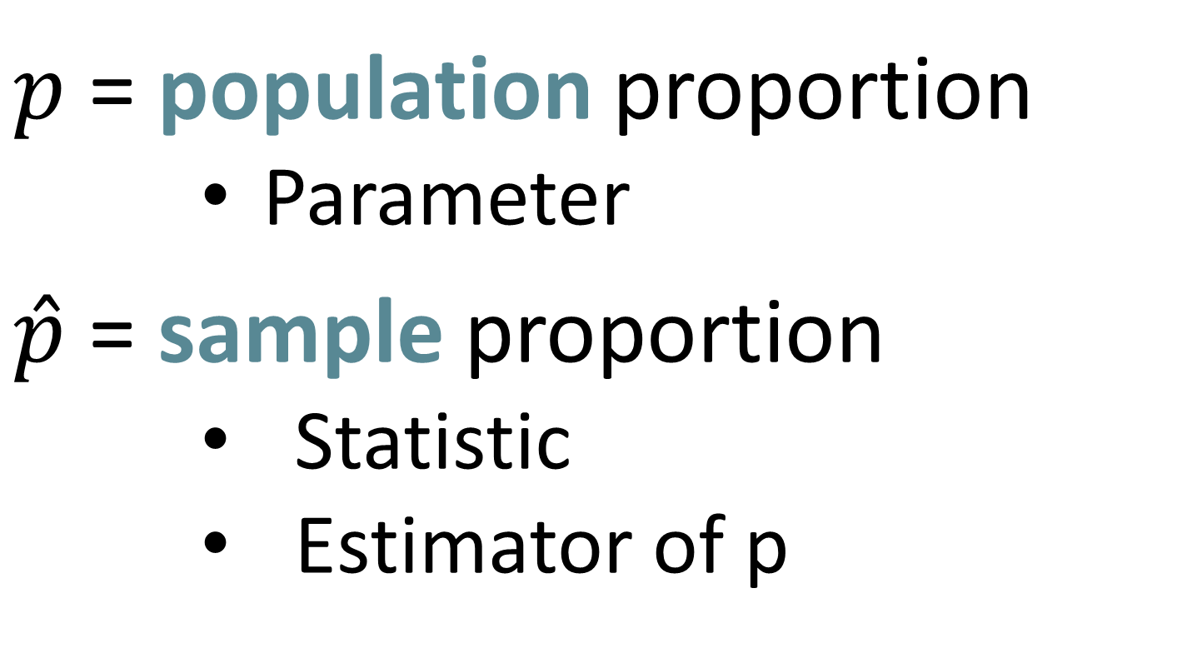
$p$ vs. $\hat{p}$
$p$ = population proportion
Parameter
$\hat{p}$ = sample proportion
Statistic
Estimator of p

Slide 3
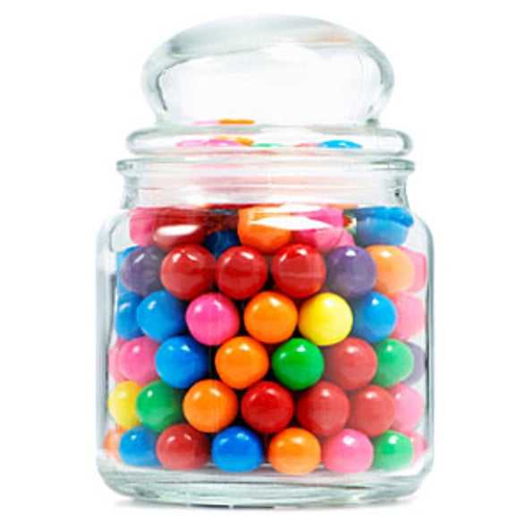

Slide 4
the true proportion
p=0.6
- Blue
- Other color

Slide 5

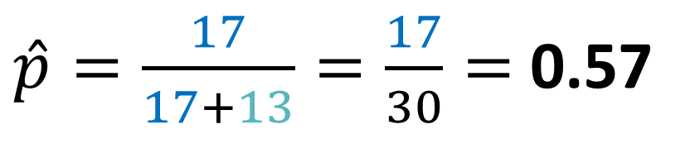
the true proportion p=0.6
$\hat{p}=\frac{17}{17+13}=\frac{17}{30}=$ 0.57
Population
Sample

Slide 6
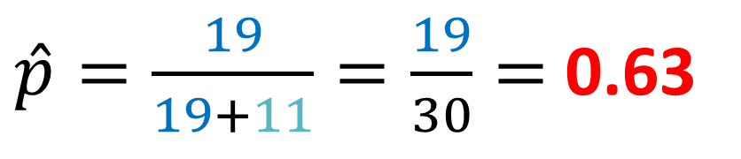
the true proportion p=0.6
$\hat{p}=\frac{19}{19+11}=\frac{19}{30}=$ 0.63
Population
Sample

Slide 7
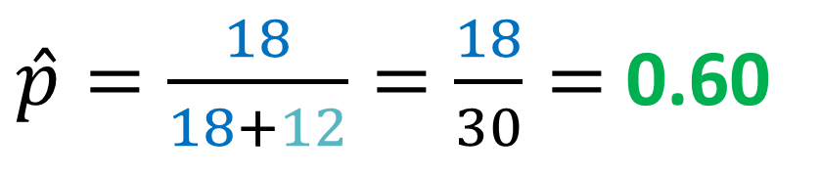
the true proportion p=0.6
$\hat{p}=\frac{18}{18+12}=\frac{18}{30}=$ 0.60
Population
Sample

Slide 8

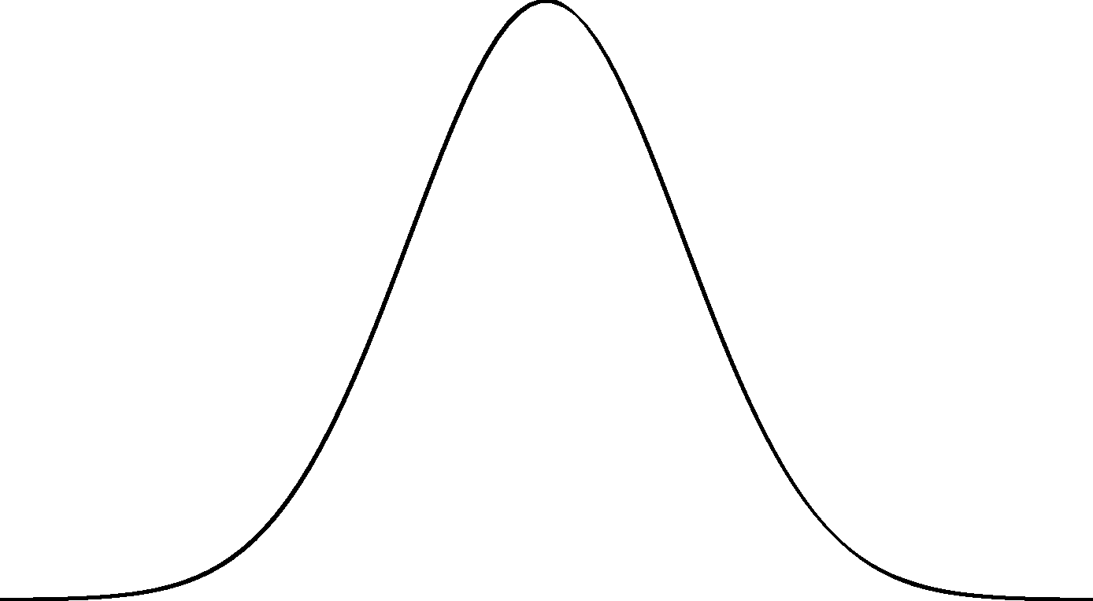




















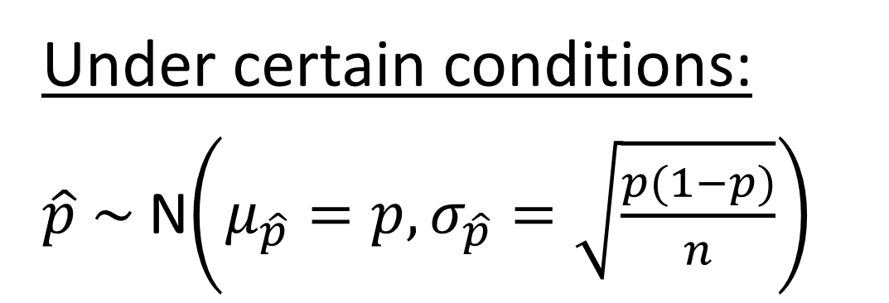
































Sampling Distribution (Proportion)
?????
Under certain conditions:
$\hat{p} \sim$N$\left(μ_{\hat{p}}=p,σ_{\hat{p}}=\sqrt{\frac{p(1−p)}{n}}\right)$
$$\hat{p}$$
$$\hat{p}$$
$$\hat{p}$$
$$\hat{p}$$
$$\hat{p}$$
$$\hat{p}$$
$$\hat{p}$$
$$\hat{p}$$
$$\hat{p}$$
$$\hat{p}$$
$$\hat{p}$$
$$\hat{p}$$
$$\hat{p}$$
$$\hat{p}$$
$$\hat{p}$$
$$\hat{p}$$
$$\hat{p}$$
$$\hat{p}$$
$$\hat{p}$$
$$\hat{p}$$
$$\hat{p}$$
$$\hat{p}$$
$$\hat{p}$$
$$\hat{p}$$
$$\hat{p}$$
$$\hat{p}$$
$$\hat{p}$$
$$\hat{p}$$
$$\hat{p}$$
$$\hat{p}$$
$$\hat{p}$$
$$\hat{p}$$
$$\hat{p}$$
$$\hat{p}$$
$$\hat{p}$$
$$\hat{p}$$
$$\hat{p}$$
$$\hat{p}$$
$$\hat{p}$$
$$\hat{p}$$
$$\hat{p}$$
$$\hat{p}$$
$$\hat{p}$$
$$\hat{p}$$
$$\hat{p}$$
$$\hat{p}$$
$$\hat{p}$$
$$\hat{p}$$
$$\hat{p}$$
$$\hat{p}$$
$$\hat{p}$$
$$\hat{p}$$
0
.1
.2
.3
.4
.5
p = .6
.7
.8
.9
1

Slide 9
Practice
Suppose there are 1000 balls with different colors in a jar. The manufacturer says that exactly 60% of the balls are blue. If we select a sample of 50 balls, how many will be blue?
Let X = the number of blue balls in the sample.
What type of probability distribution does X have?
X ~ Binom(50,0.6)

Slide 10
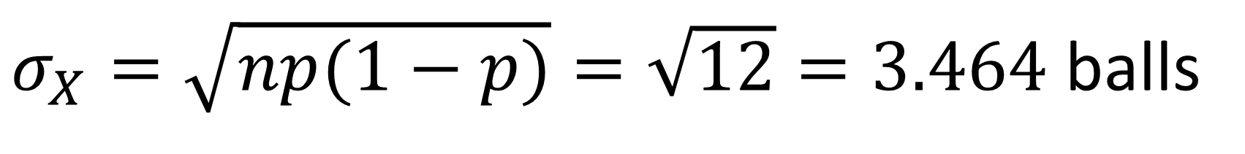
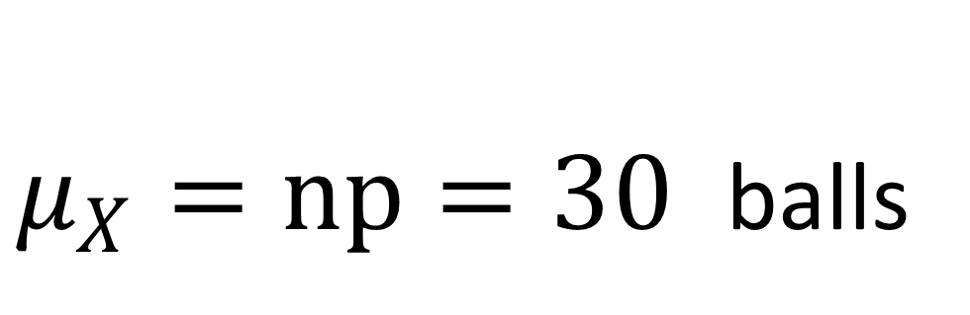
Practice
Suppose there are 1000 balls with different colors in a jar. The manufacturer says that exactly 60% of the balls are blue. If we select a sample of 50 balls, how many will be blue?
Let X = the number of blue balls in the sample.
$μ_{X}=np=30$ balls
What is the mean and standard deviation of X?
$σ_{X}=\sqrt{np(1−p)}=\sqrt{12}=3.464$ balls

Slide 11
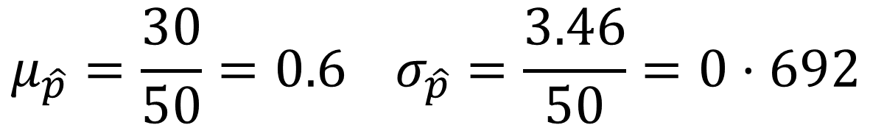
Practice
Suppose there are 1000 balls with different colors in a jar. The manufacturer says that exactly 60% of the balls are blue. If we select a sample of 50 balls, how many will be blue?
Instead of finding the number of balls that are blue, we will now find the proportion of balls that are blue.
Find the new mean and standard deviation of sample proportion.
$$μ_{\hat{p}}=\frac{30}{50}=0.6 σ_{\hat{p}}=\frac{3.46}{50}=0⋅692$$

Slide 12
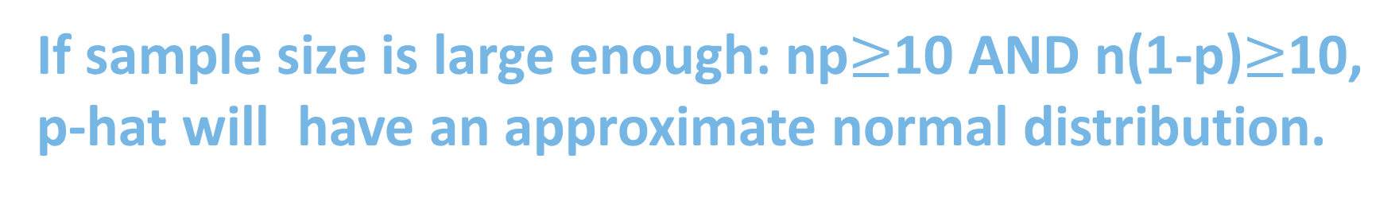
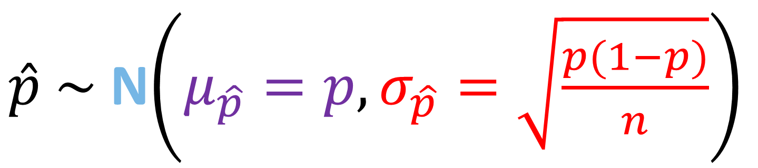
“Under certain conditions”
10% condition：
n<10%*N
Randomly sampling
$\hat{p} \sim$N$\left(μ_{\hat{p}}=p,σ_{\hat{p}}=\sqrt{\frac{p(1−p)}{n}}\right)$
sampling with replacement = without replacement
If sample size is large enough: np$≥$10 AND n(1-p)$≥$10,
p-hat will have an approximate normal distribution.

Slide 13
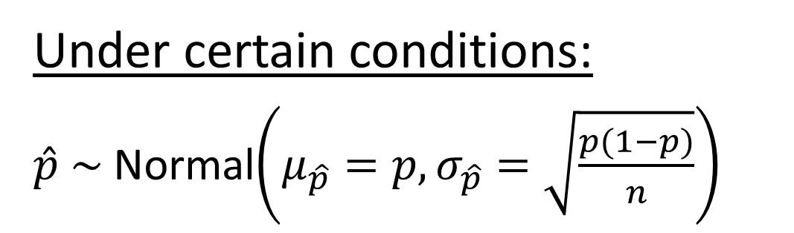
Sampling Distribution (Proportion)
Under certain conditions:
$\hat{p} \sim$Normal$\left(μ_{\hat{p}}=p,σ_{\hat{p}}=\sqrt{\frac{p(1−p)}{n}}\right)$
$$\hat{p}$$
$$\hat{p}$$
$$\hat{p}$$
Centered at true proportion, meaning the estimates are unbiased.
$$\hat{p}$$
$$\hat{p}$$
$$\hat{p}$$
$$\hat{p}$$
$$\hat{p}$$
$$\hat{p}$$
$$\hat{p}$$
$$\hat{p}$$
$$\hat{p}$$
$$\hat{p}$$
$$\hat{p}$$
$$\hat{p}$$
$$\hat{p}$$
$$\hat{p}$$
$$\hat{p}$$
p = .6
$$\hat{p}$$
$$\hat{p}$$
$$\hat{p}$$
$$\hat{p}$$
$$\hat{p}$$
$$\hat{p}$$
$$\hat{p}$$
$$\hat{p}$$
$$\hat{p}$$
$$\hat{p}$$
$$\hat{p}$$
$$\hat{p}$$
$$\hat{p}$$
$$\hat{p}$$
$$\hat{p}$$
$$\hat{p}$$
$$\hat{p}$$
$$\hat{p}$$
$$\hat{p}$$
$$\hat{p}$$
$$\hat{p}$$
$$\hat{p}$$
$$\hat{p}$$
$$\hat{p}$$
$$\hat{p}$$
$$\hat{p}$$
$$\hat{p}$$
$$\hat{p}$$
$$\hat{p}$$
$$\hat{p}$$
$$\hat{p}$$
$$\hat{p}$$
$$\hat{p}$$
$$\hat{p}$$
0
.1
.2
.3
.4
.5
.6
.7
.8
.9
1

Slide 14
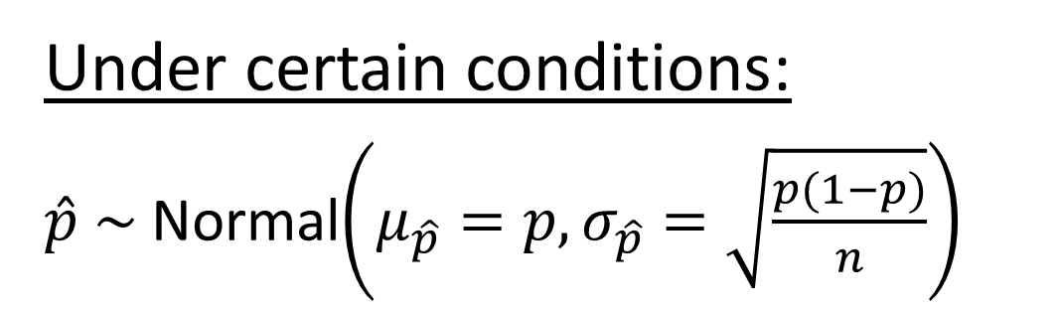
Sampling Distribution (Proportion)
Under certain conditions:
$\hat{p} \sim$Normal$\left(μ_{\hat{p}}=p,σ_{\hat{p}}=\sqrt{\frac{p(1−p)}{n}}\right)$
$$\hat{p}$$
$$\hat{p}$$
$$\hat{p}$$
We divide by n, so spread affected by sample size. Higher sample size means less variation.
$$\hat{p}$$
$$\hat{p}$$
$$\hat{p}$$
$$\hat{p}$$
$$\hat{p}$$
$$\hat{p}$$
$$\hat{p}$$
$$\hat{p}$$
$$\hat{p}$$
$$\hat{p}$$
$$\hat{p}$$
$$\hat{p}$$
$$\hat{p}$$
$$\hat{p}$$
$$\hat{p}$$
p = .6
$$\hat{p}$$
$$\hat{p}$$
$$\hat{p}$$
$$\hat{p}$$
$$\hat{p}$$
$$\hat{p}$$
$$\hat{p}$$
$$\hat{p}$$
$$\hat{p}$$
$$\hat{p}$$
$$\hat{p}$$
$$\hat{p}$$
$$\hat{p}$$
$$\hat{p}$$
$$\hat{p}$$
$$\hat{p}$$
$$\hat{p}$$
$$\hat{p}$$
$$\hat{p}$$
$$\hat{p}$$
$$\hat{p}$$
$$\hat{p}$$
$$\hat{p}$$
$$\hat{p}$$
$$\hat{p}$$
$$\hat{p}$$
$$\hat{p}$$
$$\hat{p}$$
$$\hat{p}$$
$$\hat{p}$$
$$\hat{p}$$
$$\hat{p}$$
$$\hat{p}$$
$$\hat{p}$$
0
.1
.2
.3
.4
.5
.6
.7
.8
.9
1

Slide 15



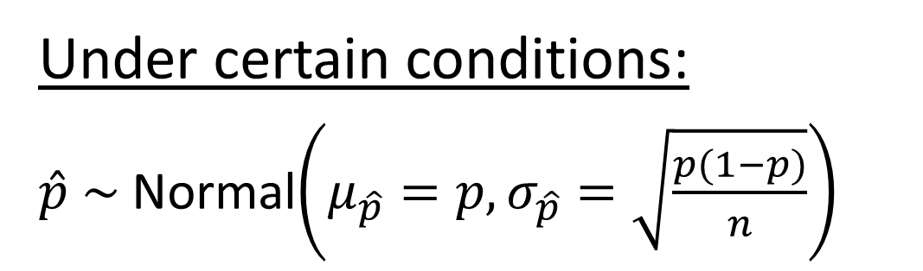
















Spread and Sample Size
Under certain conditions:
$\hat{p} \sim$Normal$\left(μ_{\hat{p}}=p,σ_{\hat{p}}=\sqrt{\frac{p(1−p)}{n}}\right)$
$$\hat{p}$$
Raising the sample size makes estimates more precise.
$$\hat{p}$$
$$\hat{p}$$
$$\hat{p}$$
$$\hat{p}$$
$$\hat{p}$$
$$\hat{p}$$
$$\hat{p}$$
$$\hat{p}$$
$$\hat{p}$$
$$\hat{p}$$
$$\hat{p}$$
$$\hat{p}$$
$$\hat{p}$$
$$\hat{p}$$
$$\hat{p}$$
$$\hat{p}$$
$$\hat{p}$$
$$\hat{p}$$
0
.1
.2
.3
.4
.5
p = .6
.7
.8
.9
1

Slide 16
https://www.rossmanchance.com/applets/2021/oneprop/OneProp.htm?candy=1
Have a try!!!

Slide 17
The sampling distribution
of the difference
in sample proportions

Slide 18
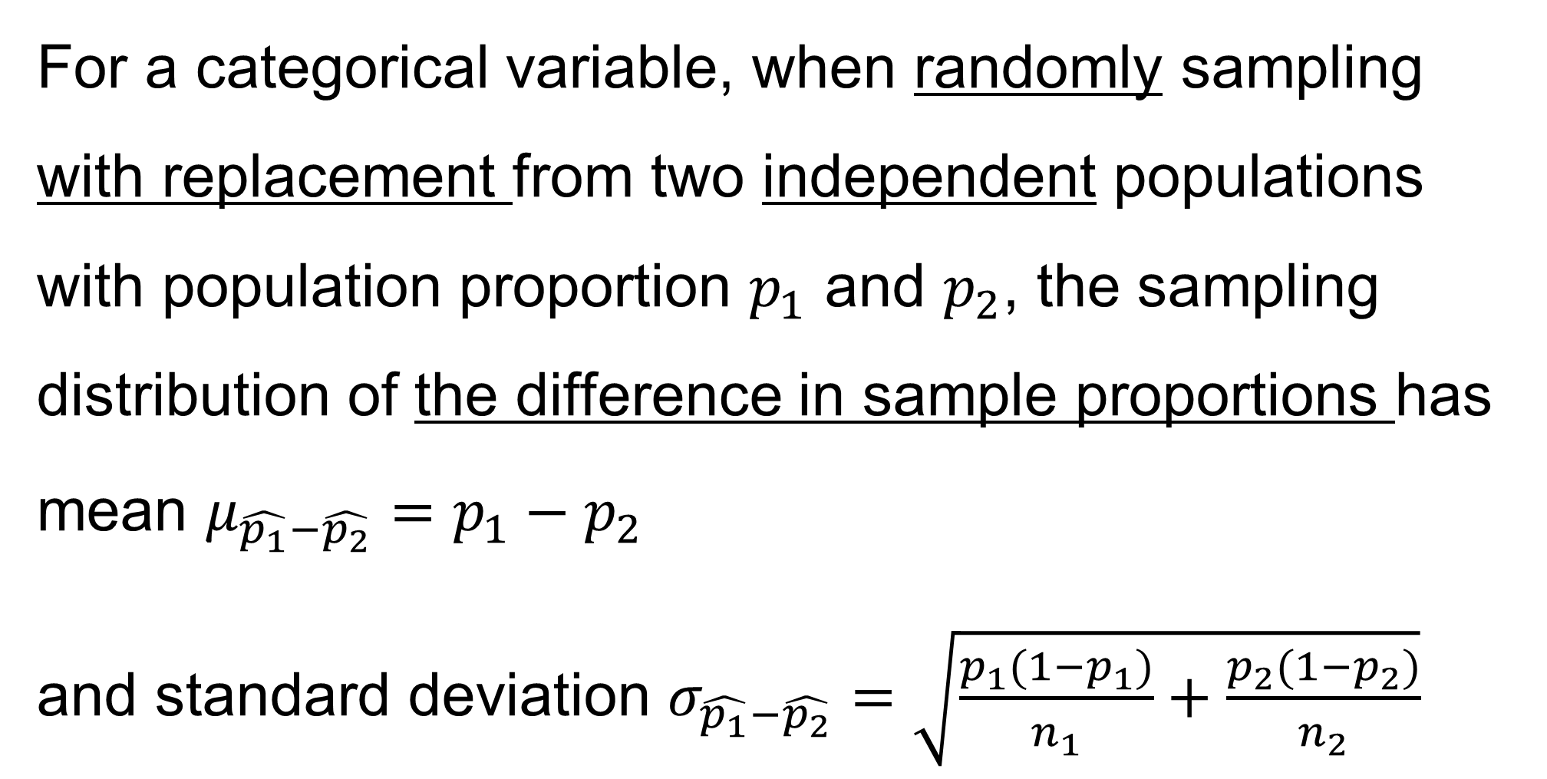
For a categorical variable, when randomly sampling with replacement from two independent populations with population proportion $p_{1}$ and $p_{2}$, the sampling distribution of the difference in sample proportions has mean $μ_{\hat{p_{1}}−\hat{p_{2}}}=p_{1}−p_{2}$
and standard deviation $σ_{\hat{p_{1}}−\hat{p_{2}}}=\sqrt{\frac{p_{1}(1−p_{1})}{n_{1}}+\frac{p_{2}(1−p_{2})}{n_{2}}}$

Slide 19
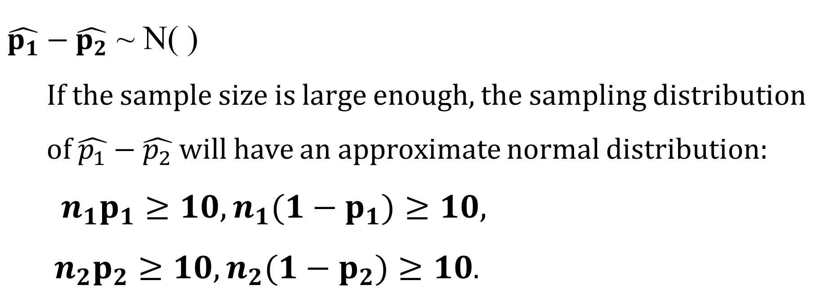
$\hat{p_{1}}−\hat{p_{2}}$ ~ N( )
If the sample size is large enough, the sampling distribution of $\hat{p_{1}}−\hat{p_{2}}$ will have an approximate normal distribution:
${n_{1}p}_{1}≥10,{n_{1}(1−p}_{1})≥10,$
${n_{2}p}_{2}≥10,{n_{2}(1−p}_{2})≥10$.

